Slide 1
Applied Data Science Modeling
Dr. Omri Allouche
2017

Slide 2
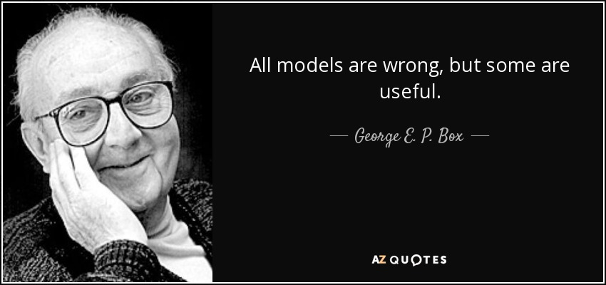

Slide 3
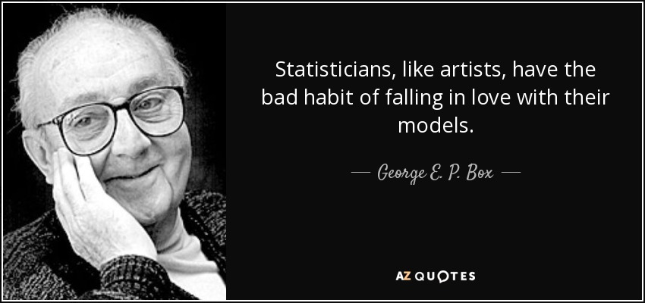

Slide 4
